Slide 1
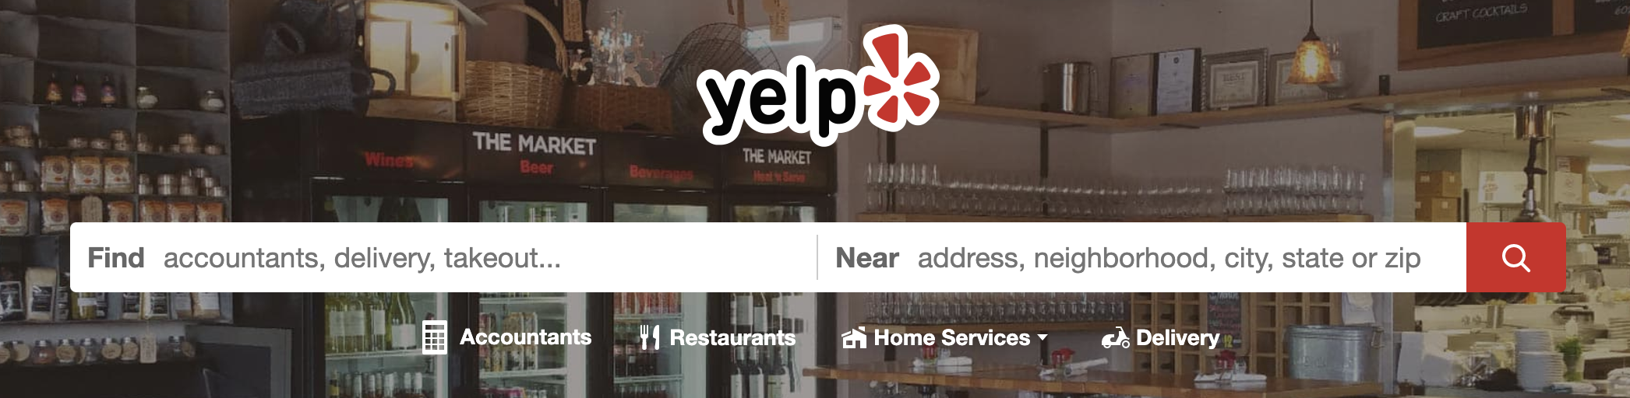

Search Group Project
Course: Z534 Search
Instructor: Xiaozhong Liu
Group: Sanket Pandilwar, Akshay Kowshik, Camilla Tan

Slide 2
Our Questions
What CF approach perform well for recommender system?
Classification of a restaurant based on sentiment scores of reviews and tips?
Notes:
why it can be significant

Slide 3



Members Role
Prediction model, Sentiment Analysis and Data Visualization
EDA, Collaborative Filtering and Presentation
Part of collaborative filtering and Part of classification of restaurants based on sentiment analysis

Slide 4
Dataset Overview
Yelp data files we used: business.json, review.json, user.json, tips.json, and checkin.json
5.1M Reviews in Review.json
210K Businesses in Business.json
1.97M Users in Users.json

Slide 5
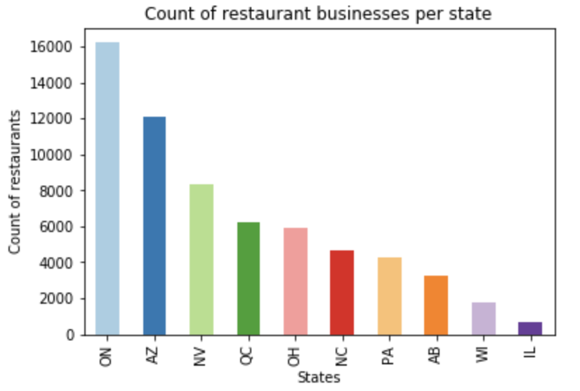
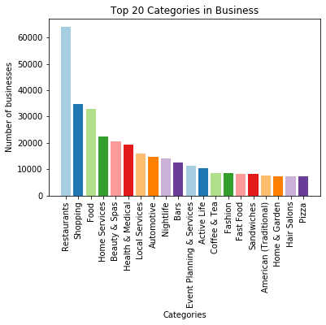
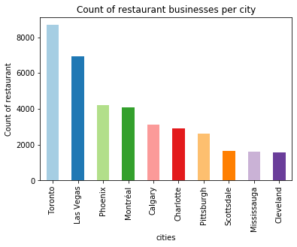
Data Visualization

Slide 6
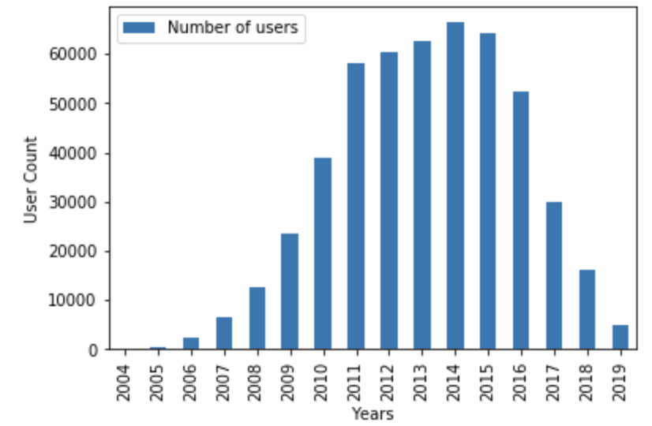
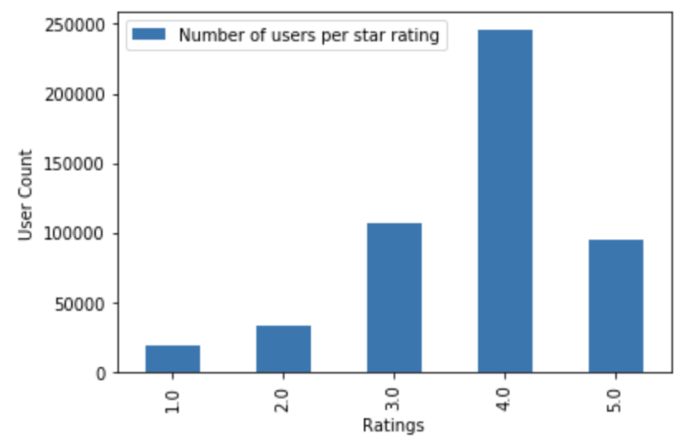
Yelp User Overview

Slide 7
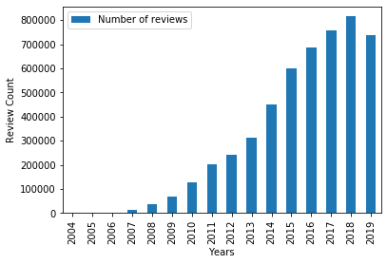
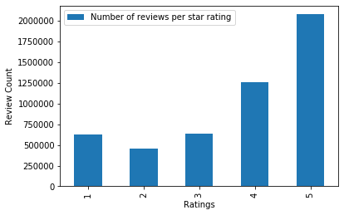
Yelp Review Overview

Slide 8
Data Processing
Considered only Restaurant Businesses from Las Vegas City.
Picked users who have rated more than 100 reviews.
Training and testing data was divided into 80-20 split.

Slide 9
Task 1

Slide 10
Collaborative Filtering
Approaches:
Item Based
User Based
Techniques:
Memory Based
Model Based

Slide 11
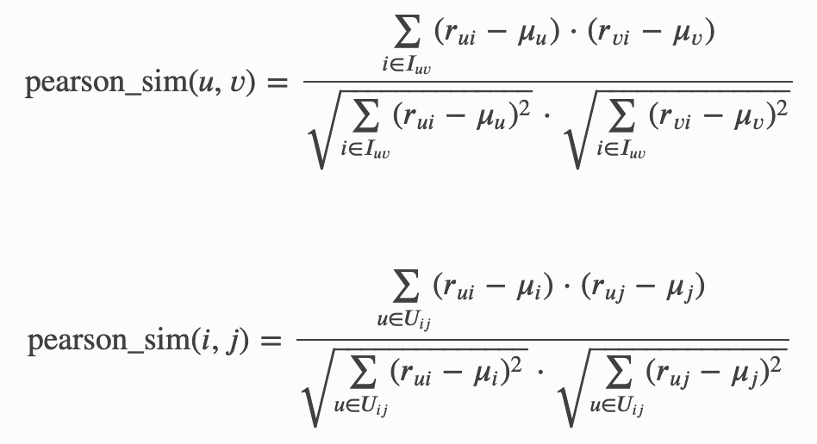
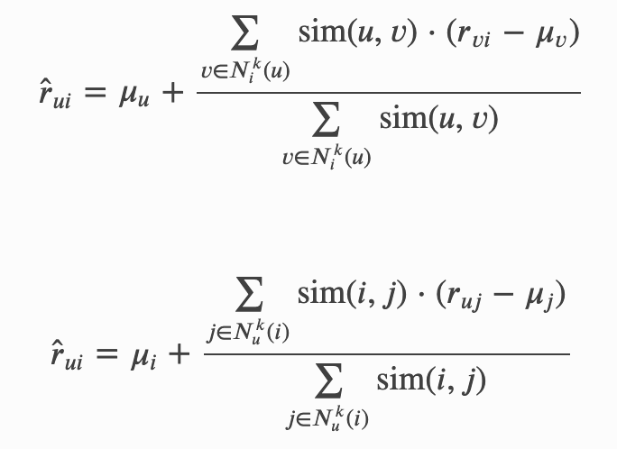
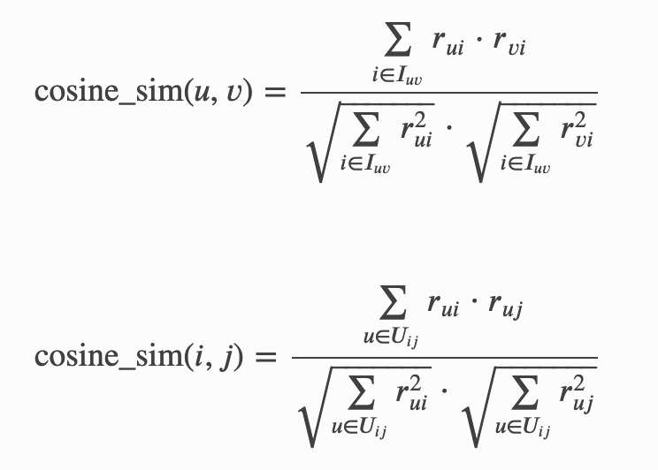
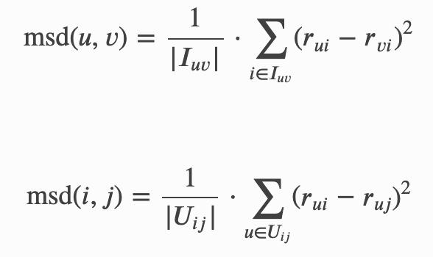
Methods
3 types of similarity metrics
Pearson correlation coefficient
Memory based KNN
Mean Squared Difference
Cosine similarity

Slide 12
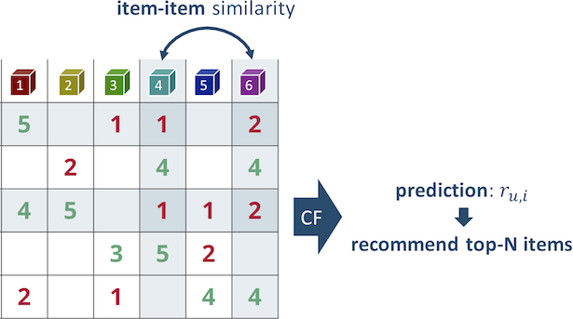
Item-Based CF
Result
Recommendations for Restaurant
Loftti Cafe on similarity basis:
1: To See Roll
2: Brew Tea Bar
3: Cafe Summer
4: Zen Curry Express
5: Snow White Cafe
6: Is Sweet
7: Cafe 86
8: Dirt Dog - Las Vegas
9: Tea Space
10: Eis Cream Cafe
Item based: utilize the star ratings from the restaurant to find similar rated restaurants, and recommend similar restaurant.
We used KNN approach in different similarity metrics: K nearest neighbor by cosine similarity, pearson correlation coefficient and msd (Mean Squared Difference similarity)

Slide 13
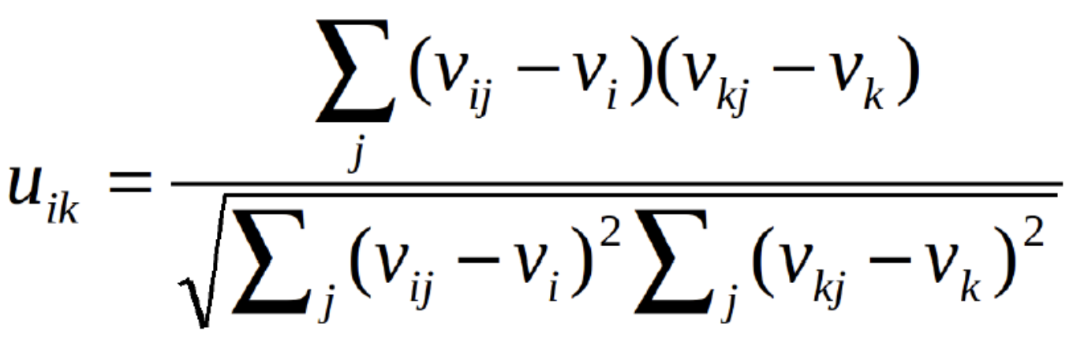
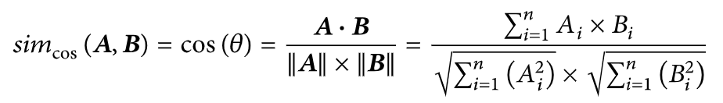
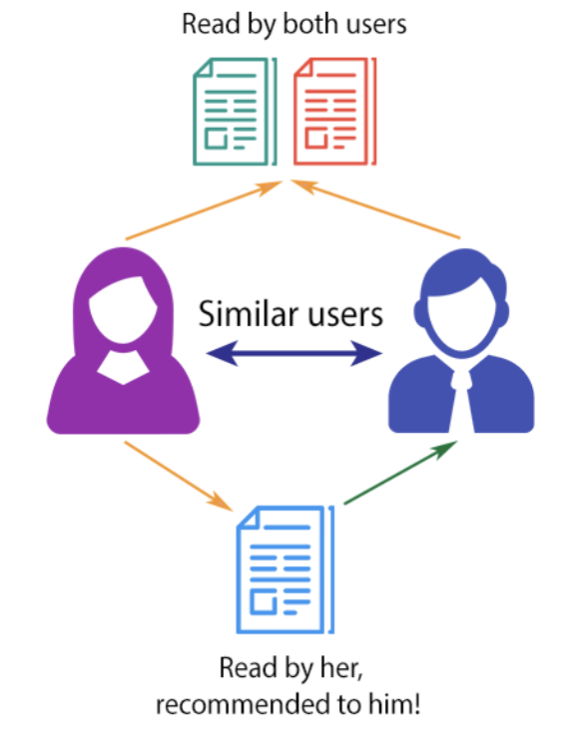
User-based CF
User based: build from users’ past behaviors: similar decision/ratings on restaurants
Compute cosine similarity, pearson correlation coefficient and msd similarity matrix with KNN
Evaluation
Computing the cosine similarity matrix...
RMSE: 1.4969
MSE: 2.2407
MAE: 1.1106
Computing the pearson similarity matrix...
RMSE: 1.4309
MSE: 2.0475
MAE: 0.9740
Computing the msd similarity matrix...
RMSE: 1.4657
MSE: 2.1482
MAE: 1.0462
Best rmse score: 1.0008027509399238

Slide 14
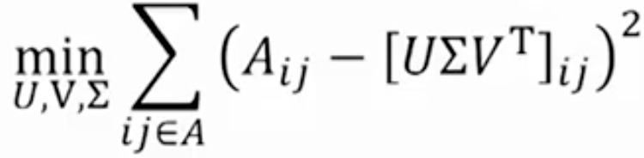
Model-based CF
Goal: to achieve minimal RMSE
SVD Approach: keep known data, ignore unseen data to optimize the sparsity and scalability issue. E.g users don’t give rating to every restaurant make the matrix sparse.
Singular Value decomposition (SVD) is a matrix factorization technique that is used to reduce the number of features of a data set by reducing space dimensions from N to K where K < N.
Grid search: optimize parameters by cross-validated grid-search over a parameter grid.
Try:
param_grid = {
"n_epochs": [5, 10, 20],
"lr_all": [0.002, 0.005],
"reg_all": [0.2, 0.4, 0.6]
}
Best rmse score: 0.9729767140598804
Best parameters: {'n_epochs': 20, 'lr_all': 0.005, 'reg_all': 0.2}

Slide 15
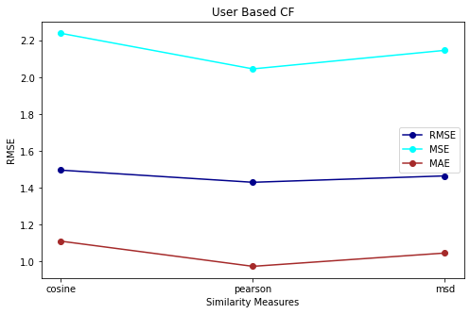
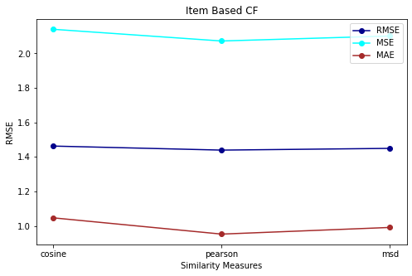
Pros & Cons Comparison
Our similarity measure comparison for KNN
User based:
Assume users’ taste will still be the same
Sparsity issue: The percentage of people who rate items is really low.
The more users in the system, the greater cost of finding the nearest K neighbors will be.
New user might have no rating(cold start problem)
Item based:
Lower rmse/mse/mae based on our evaluation
Can calculate offline in advance for new users
Cannot capture users’ interests overtime
Pearson correlation score the best on its lowest rmse score based on evaluation

Slide 16
Comparing Item-based CF (Ratings vs Text)
Rating:
Recommendations for Restaurant Delhi Indian Cuisine on similarity basis:
1: Big Wong Restaurant
2: Art of Flavors
3: Mt Everest India's Cuisine
4: Mint Indian Bistro
5: El Cachi Mexican Kitchen
6: Japanese Cuisine By Omae
7: SLO-Boy
8: Indian Bowl Cuisine
9: Nem Nuong Bistro
10: Chao Thai Restaurant
Text: ( Using TF-IDF scores as weights )
Recommendations for Restaurant Delhi Indian Cuisine on similarity basis:
1: Namaste Indian Cuisine
2: Mt Everest India's Cuisine
3: Angara India Spice Grill
4: Mint Indian Bistro
5: Tamba
6: Taj Palace
7: Paradise India
8: India Oven Masala Bar & Grill
9: Mint Indian Bistro
10: India Palace

Slide 17
Observation & improvement
Since the distribution of ratings are uneven, we undersampled datasets to get a balanced dataset, so each rating star has similar proportion, which alsos improved the rmse in the evaluation
Model based SVD

Slide 18
Limitation & Future works
Does not address cold-start problem
Not useful unless we have more data since matrix is very sparse

Slide 19
Task 2

Slide 20
Classification of Restaurants based on Sentiment Analysis
We all know how important the business reviews are for its ratings. In fact it is almost directly proportional.
Better the reviews, better are the stars of the business. Everyone in this modern world first check for reviews before going to a restaurant
Integrating the sentiments of customers to predict how good the restaurant is.

Slide 21
USE OF SENTIMENT ANALYSIS
Enhancing Customer Experience: The experience of the customers can either be positive, negative or neutral. This helps business to know what needs to be improved and what is properly being implemented.
Getting a positive response is just not enough,customer support system should always be the top priority
When you improve the users experience and meet accordingly to their needs is what leads to an attraction of the customers. This in turn leads to Market growth

Slide 22
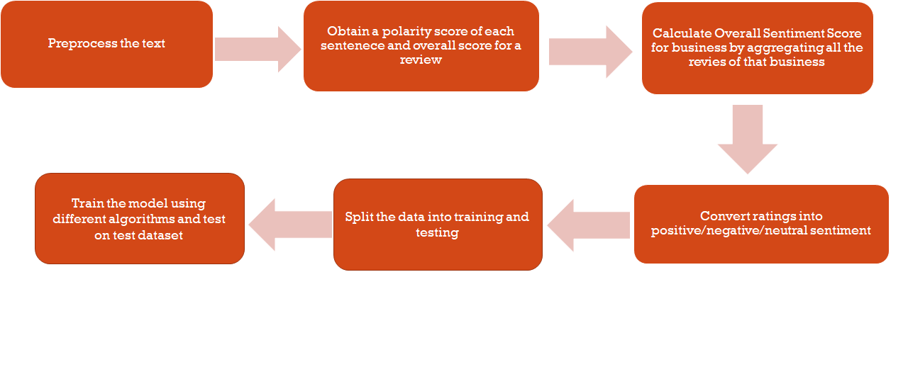
Approach

Slide 23
Lemmatization vs Stemming
Stemming algorithms work by cutting off the end or the beginning of the word, taking into account a list of common prefixes and suffixes that can be found in an inflected word.
Lemmatization, on the other hand, takes into consideration the morphological analysis of the words. The key to this methodology is linguistics. To extract the proper lemma, it is necessary to look at the morphological analysis of each word. This requires having dictionaries for every language to provide that kind of analysis.
For example: The word caring after stemming becomes car and after lemmatization it becomes care.
We used nltk python standard library to implement lemmatization.

Slide 24
Calculating Sentiment Score
Polarity of Sentence = Sum of polarity of all the words in a sentence divided by the total number of words in the sentence
If the sentiment score was greater than zero then a initial polarity of 1 was given to that particular review or tip. This means its a positive sentiment.
If the sentiment score was less than zero, then a initial polarity of 0 was given to that particular review. This means its a negative sentiment.
Now we know different business have different number of reviews. So it would be better to obtain a overall sentiment score.
Net Positive Sentiment Score = Sum(Sentiment score for that business) / Total number of reviews
Now the overall idea is to use this score which indicates the sentiment as one of the key features in our prediction model.

Slide 25
Turning it to a Multi-level Classification Problem
Our final objective is to predict the how good that restaurant was. For this we have made the following assumption and classified the restaurant as follows
If average review stars for that restaurant is:
>= 3.5 : Positive sentiment i.e restaurant is amazing
=3.0 : Neutral Sentiment i.e restaurant is average
<3.0 : Negative Sentiment i.e restaurant is not so good
Now we can use this as the label of our model.

Slide 26
Training and Testing of our Model
Our data set was divided into training and testing in the ratio of 70 : 30
We used various algorithms to train our model: Viz., SVM, Decision Tree, Logistic Regression, Naive Bayes, KNN, Random Forest, Ada Boost, and Multi-layer Perceptron.

Slide 27
Evaluation
Evaluation Metrics used are Accuracy, Precision, Recall, and F1 Score
Sample Evaluation:
Evaluations for Decision Tree Classifier
PRECISION RECALL F1_SCORE ACCURACY
Train 0.368180 0.719157 0.346247 0.688926
Test 0.547542 0.569092 0.509591 0.680710

Slide 28
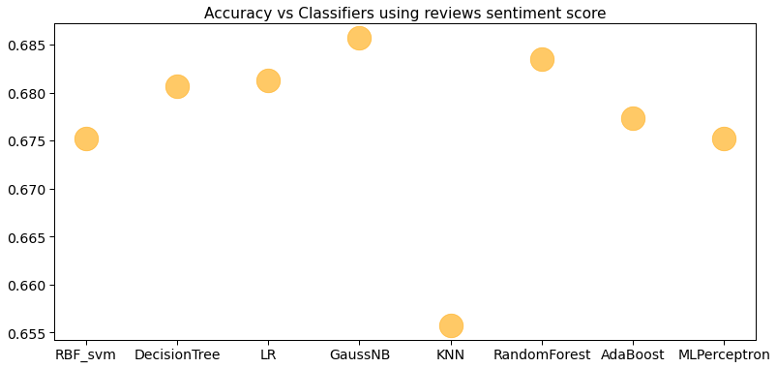
Accuracy vs Classifiers

Slide 29
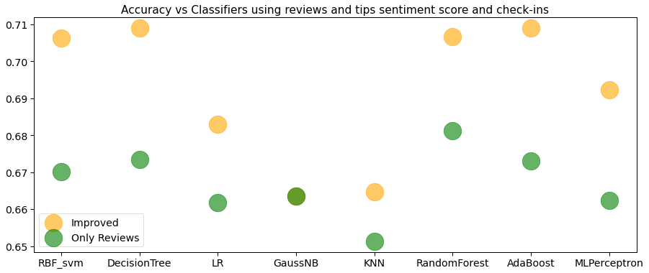
After adding sentiment score of tips and check-ins data as a feature

Slide 30
Conclusion and Future References
NLP being such a huge and blooming domain,it’s always difficult to preprocess the text
How-Much-Ever and Whatever you do , there is always something which can be done better. Such is the nature of the domain.
Future work could involve the usage of deep learning algorithms for NLP and it might lead to better accuracy. The better the text is preprocessed and captured efficiently, better are the results.
Also using more features to improve our prediction model.

Slide 31
References
https://www.hindawi.com/journals/mpe/2018/9617410/
https://medium.com/@m_n_malaeb/singular-value-decomposition-svd-in-recommender-systems-for-non-math-statistics-programming-4a622de653e9
https://scikit-learn.org/stable/modules/generated/sklearn.model_selection.GridSearchCV.html
https://blog.bitext.com/what-is-the-difference-between-stemming-and-lemmatization/
https://medium.com/@cfpinela/recommender-systems-user-based-and-item-based-collaborative-filtering-5d5f375a127f

Slide 32
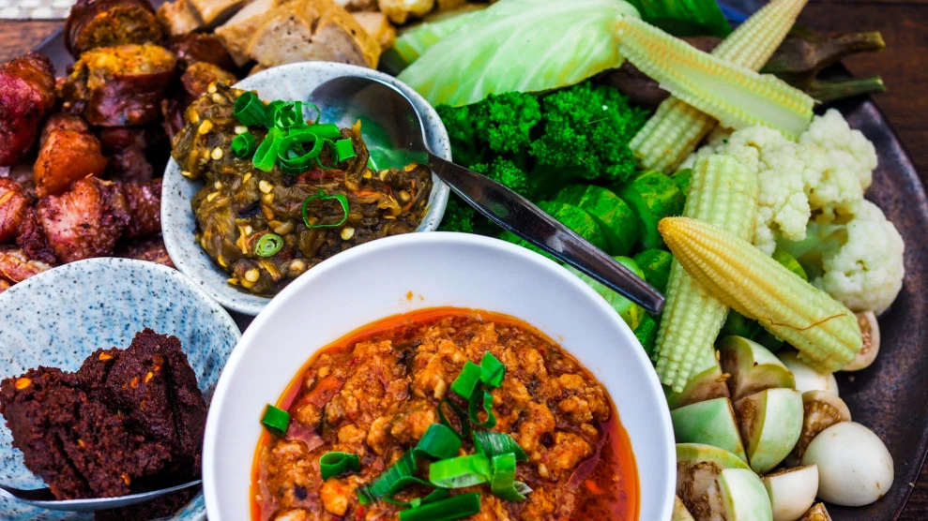
Thank you for listening!

